Slide 1
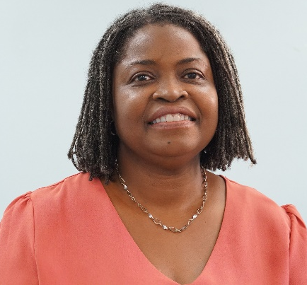
BIOSAFETY IN SMALL ISLAND DEVELOPING STATES: THE EDUCATION AGENDA
MS. ANGELA T. ALLEYNE
Programme Coordinator MSc/Diploma in Biosafety,
The University of the West indies Cave Hill Campus
Department of Biological and Chemical Sciences
Barbados

Slide 2
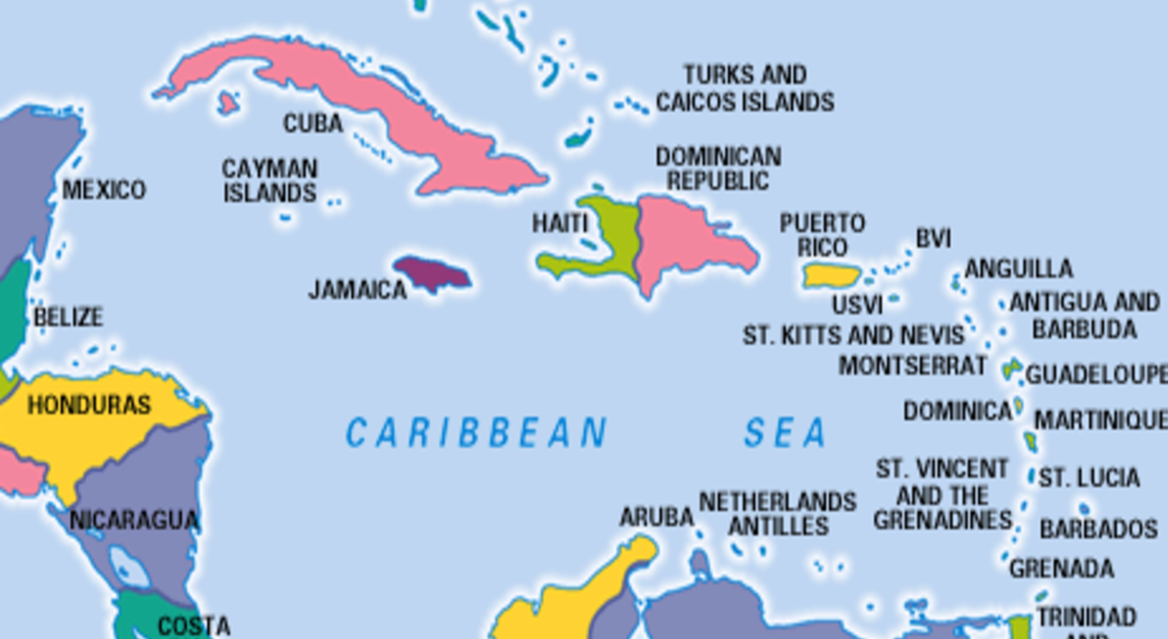
MSC/Diploma in Biosafety
University of the West indies
Students from as far as Belize in the north to Suriname in the south and
the islands in between.
15 -month full time course of study in theoretical, legal and practical aspects of Biosafety.
All courses are offered in an online format, except Laboratory methods in Biosafety. This is a workshop type course scheduled dates are in June or July in a workshop-based format covering one week of practical and oneweek online tuition.
Biosafety postgraduate education
at the tertiary level since 2014.

Slide 3
Past and Current Enrollments
Barbadian students will continue to be the main students
Students have a first degree in Biological Sciences, viz. Biochemistry, Biology, Microbiology and Environmental Sciences
We are aiming to encourage even more professionals with several years of working experience to apply
37% = students from Barbados

Slide 4
MSc Diploma Biosafety/Our Goal
Create
trained Caribbean professionals in Biosafety
Display
safe Biotechnology practices
Provide
students with Biotechnology skills on risk analysis
Meet
regional and international agreements on Biosafety

Slide 5
Core concepts
Cartagena protocol
We provide information on and examine the Cartagena Protocol and other MLAs in considering Biosafety and the environment in the Caribbean island states
Action agenda
Biodiversity
Educate and analyze the impact of biotechnology on plant biodiversity
Public education
Conduct surveys through research projects to determine the level of awareness of Biosafety and Biotechnology in the region.
Build widespread awareness of the importance of safeguarding biodiversity using policy instruments, legislation, personal commitment and NGO activities

Slide 6
Where are students now?
Industry
Health sector
Laboratories
Education/teaching
As the program widens its scope 3 new course areas are being designed.
We commit to develop the course areas by 2030 more sectors with biosafety experts
New courses!!
Food Safety
Clinal Biosafety
Climate change and biosafety

Slide 7
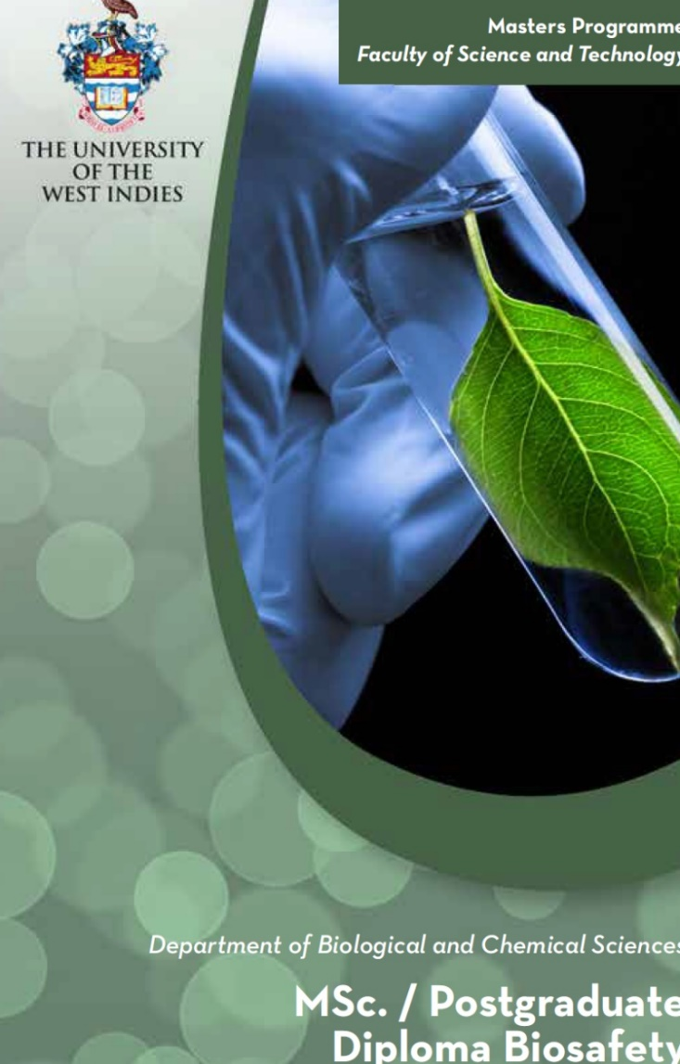
The Cartagena Protocol on Biosafety and The Action Agenda for Nature and People
We commit to introduce the action agenda as a discussion in the core course of the program Biosafety, Biotechnology and the environment
The MSc. in Biosafety program continues to:
Increase capacity in all Caribbean countries to manage potential adverse impacts of biotechnology on biodiversity and human health
Inform policy on Biosafety throughout the Caribbean region
Academic institutions as education professionals should be key partners in support of the Action Agenda

